Slide 1
Python
Input/Output, Variables, Types, Assignment

Slide 2
In this lecture
Introduction to Python
Output
Input
Types
Declaring Variables
Assigning values to variables

Slide 3
Language

Slide 4
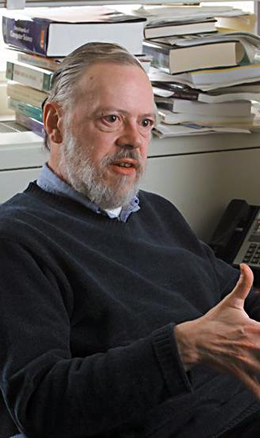
The C Language
C was first developed by Dennis Ritchie and Bell Labs in 1972
Later formally published with the book “The C Programming Language” with Brian Kernighan in 1978.
C contained primitive variables, functions, standard input and output stream, structures. The paradigm was procedural (before OO).

Slide 5
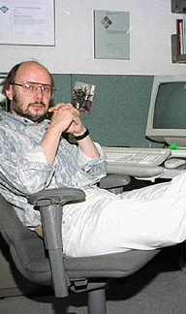
The C++ Language
C++ was developed by Bjarne Stroustroup and his team at Bell Labs throughout the 1980s.
The language was first referred to as ‘C with classes’, as it sought to apply the object oriented paradigm to the original C language.
The increment operator (++) increases the integer value of a variable by one. This indicates that C++ is the next increment of the original C language.

Slide 6
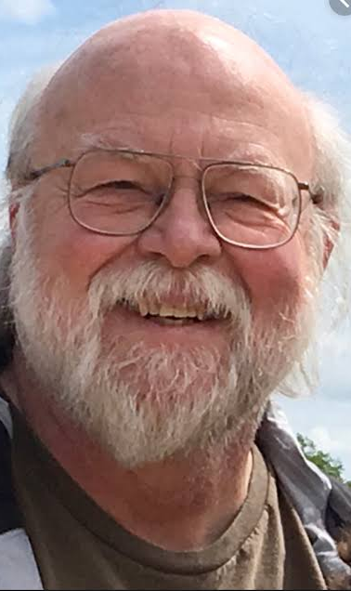
The Java Language
Java was published in 1995 by James Gosling of Sun Microsystems
Java is strongly typed (data types required) like C and C++ but utilizes a virtual machine (JVM) to run on multiple devices (portability). Also has ‘automatic garbage collection’
C# was later developed in the early 2000s to compete with Java!

Slide 7
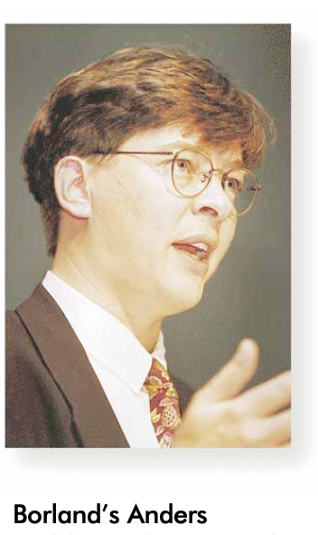
The C# Language
C# was first published in 2001, developed by Anders Heljsberg from Microsoft, alongside .NET and Visual Studio.
Close to Java syntax, and the .NET framework enables the language to run on multiple OS’ (like Java’s JVM).
C# gets its name from music; in music theory, the note C# is one semitone higher in pitch than the note C.

Slide 8
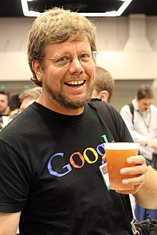
The Python Language
Python was published in 1991 by Guido Van Rossum, who was inspired by the UK show ‘Monty Python’.
Python is a loosely typed (dynamic) language which doesn’t require types to be declared.
Has grown in popularity due to data science, cyber security and AI applications.

Slide 9
Software

Slide 10




IDEs
Jupyter Notebooks
PyCharm (JetBrains)
Visual Studio Code
Google
Colaboratory

Slide 11
What is a Computer?

Slide 12
Computer
A computer program (or application) is a collection of instructions that perform a specific task.

Slide 13
Introduction to Python

Slide 14

What is Python?
“Python is a high level programming language, and its core design philosophy is all about code readability and a syntax which allows programmers to express concepts in a few lines of code.” Guido van Rossum

Slide 15
History
Python was originally developed by Dutch programmer Guido van Rossum throughout the 1980s. Guido named the language after UK comedy series Monty Python.
Python 0.9.0 was released in 1991
Python 2 was released in 2000
Python 3.0 was released in 2008
Python has gained in popularity thanks data science and national school curriculums.

Slide 16
Philosophy
First posted in 1999, and later published in the Zen of Python:
Beautiful is better than ugly.
Explicit is better than implicit.
Simple is better than complex.
Complex is better than complicated.
Readability counts.

Slide 17
Advantages
Readable: intuitive and strict syntax
Productive: saves a lot of code
Portable: for every operating system
Reloaded: it comes with many libraries

Slide 18
Python uses
Web Development: Frameworks such as Django and Flask
Data Analysis: Libraries such as NumPy, Pandas, Matplotlib
Internet of Things: Raspberry Pi + Python
Web Scraping: e.g. Scrapy
Computer Vision: e.g. OpenCV
Machine Learning: Sci-kit Learn, NLTK, TensorFlow
Game Development: PyGame

Slide 19
Output in Python First program

Slide 20
Print (1)
In[ ]:
1 | print("Hello World")
2 |

Slide 21
Print (1) running
In[ ]:
1 | print("Hello World")
2 |
Hello World

Slide 22
Print (2)
In[ ]:
1 | print("Hello Nick")
2 | print("Your ID is 12345678")

Slide 23
Print (2) running
In[ ]:
1 | print("Hello Nick")
2 | print("Your ID is 12345678")
Hello Nick
Your ID is 12345678

Slide 24
Variables

Slide 25
What are Variables?
Variables are a way to store data temporarily in our programs.
Just like the word variable implies, this data can vary; it can change throughout the course of the program.
We can store data (value) by assigning it (=) to a memory location. That memory location is then referred to by a variable name.
The value is stored at a memory address (RAM, which is temporary memory) and can then be accessed through the variable name)
The opposite of a value changing throughout the program would be a constant, which never changes; it has a fixed value.

Slide 26
Variables in C and Java
In C, C++, C# and Java, the programmer would have to first define the data type, then a meaningful name for the variable:
String name = "Nick";
data type
name that refers to memory location
assignment operator
value

Slide 27
Variables in Python
Python does not require the type to be stated! Although it is good to be aware of types…
It is good practice to consider the name of your variable (storage area) and of course what value you will store there:
name = "Nick"
name that refers to memory location
assignment operator
value

Slide 28
Types and Names

Slide 29
Numeric types
Types are built as classes (more on this concept later).
The two main numeric types are int and float.
int deals with whole numbers: 10, 60, 0, -9
float deals with decimal numbers: 10.6, 7.25,

Slide 30
Other types
Types are built as classes (more on this concept later).
str (string) can store a combination of characters: "n", "Nick",
It is also possible to use single quotes: 'Nick’
bool can store values True or False

Slide 31
Types
Type | Declaration | Example | Usage
Integer | int | x = 30 | Whole numbers
Float | float | x = 3.14 | Decimal points
String | str | x = "Hello" | Text
Boolean | bool | x = True | Binary results
NoneType | None | x = None | Empty / Null var

Slide 32
Variable Names
Important to select meaningful names that describe the value
Best practice to start variable names with a letter or '_'
Cannot have spaces in the variable name (Python convention is '_')^{[1]}
Cannot be a reserved word (int, for, if etc).
Beware of casing: 'NAME' and 'name' are different variables!

Slide 33
Assignment in Python

Slide 34
Assignment (=)
We can store data (value) by assigning it (=) to a memory location. That memory location is then referred to by a variable name.
Remember that the = sign in programming is different to mathematics (which compares two sides of the equation)!

Slide 35
Assignment
variable = value

Slide 36
Assignment
variable = value
name that refers to memory location
assignment operator
data

Slide 37
Assignment
name = "Nick"
name that refers to memory location
assignment operator
data

Slide 38
Variables (1)
In[ ]:
1 | name = "Nick"
2 |

Slide 39
Variables (1)
In[ ]:
1 | name = "Nick"
2 | print("Hello", name)

Slide 40
Variables (1)
In[ ]:
1 | name = "Nick"
2 | print("Hello", name)
Hello Nick

Slide 41
Concatenation
In[ ]:
1 | name = "Nick"
2 | print("Hello" + name)

Slide 42
Concatenation
In[ ]:
1 | name = "Nick"
2 | print("Hello" + name)
HelloNick

Slide 43
Concatenation
In[ ]:
1 | name = "Nick"
2 | print("Hello " + name)

Slide 44
Concatenation
In[ ]:
1 | name = "Nick"
2 | print("Hello " + name)
Hello Nick

Slide 45
Alternatively
In[ ]:
1 | name = "Nick"
2 | name

Slide 46
Alternatively
In[ ]:
1 | name = "Nick"
2 | name
Nick

Slide 47
Variables (2)
In[ ]:
1 | name = "Nick"
2 | age = 30
3 | print("Hello", name, "you are", age)

Slide 48
Variables (2)
In[ ]:
1 | name = "Nick"
2 | age = 30
3 | print("Hello", name, "you are", age)
Hello Nick you are 30

Slide 49
String formatting
d, i | Integer
u | Unsigned Integer
f | Floating point as m.ddddd
e | Floating point as m.ddddde+/-xx
E | Floating point as m.dddddE+/-xx
g | Use %e for exponents <-4 or >+5, otherwise use %f
c | Single character
s | String, or any object that be converted via str()
% | Insert a literal % character

Slide 50
String formatting
In[ ]:
1 | print("%s is %d years old" % (name, age) )
2 |
Nick is 30 years old

Slide 51
More on Types

Slide 52
Static and Dynamic
Python is dynamically typed (type checked at run-time). Variables can be initially assigned a value of one type, and then be reassigned a value of a different type!
Statically typed languages (such as C, C++, C# and Java, which check type at compile-time) only allow values of the same type to be assigned.

Slide 53
Redefining age
In[ ]:
1 | age = 30
2 | print("You are", age)
3 | age = "Nick"
4 | print("You are", age)

Slide 54
int and str
In[ ]:
1 | age = 30
2 | print("You are", age)
3 | age = "Nick"
4 | print("You are", age)
You are 30
You are Nick

Slide 55
type() function
In[ ]:
1 | age = 30
2 | print(type(age))
3 | name = "Nick"
4 | print(type(name))

Slide 56
type() function
In[ ]:
1 | age = 30
2 | print(type(age))
3 | name = "Nick"
4 | print(type(name))
<class 'int'>
<class 'str'>

Slide 57
Type Casting

Slide 58
Arithmetic
In[ ]:
1 | first_mark = 60
2 | second_mark = "40"
3 | first_mark + second_mark
4 |

Slide 59
Arithmetic
In[ ]:
1 | first_mark = 60
2 | second_mark = "40"
3 | first_mark + second_mark
4 |
----------------------------------------------------------
TypeError: unsupported operand type(s) for +: 'int' and 'str' ----------------------------------------------------------------------

Slide 60
Casting
In[ ]:
1 | first_mark = 60
2 | second_mark = int("40")
3 | first_mark + second_mark
4 |

Slide 61
Casting
In[ ]:
1 | first_mark = 60
2 | second_mark = int("40")
3 | first_mark + second_mark
4 |
100

Slide 62
Casting
In[ ]:
1 | age = int(30)
2 | print(age)
3 | age = float(30)
4 | print(age)

Slide 63
Casting
In[ ]:
1 | age = int(30)
2 | print(age)
3 | age = float(30)
4 | print(age)
30
30.0

Slide 64
Quick Quiz!

Slide 65
What will the output be?
In[ ]:
1 | first_mark = "60"
2 | second_mark = "40"
3 | first_mark + second_mark
4 |

Slide 66
Str concat vs arithmetic
In[ ]:
1 | first_mark = "60"
2 | second_mark = "40"
3 | first_mark + second_mark
4 |
'6040'

Slide 67
What will the output be?
In[ ]:
1 | str1 = "Nick is"
2 | str2 = 40
3 | str3 = "years old"
4 | print(str1 + str2 + str3)

Slide 68
Mixture of types
In[ ]:
1 | str1 = "Nick is"
2 | str2 = 40
3 | str3 = "years old"
4 | print(str1 + str2 + str3)
----------------------------------------------------------
TypeError: unsupported operand type(s) for +: 'int' and 'str’ ----------------------------------------------------------------------

Slide 69
Commas instead of +
In[ ]:
1 | str1 = "Nick is"
2 | str2 = 40
3 | str3 = "years old"
4 | print(str1, str2, str3)
Nick is 40 years old

Slide 70
Case Sensitivity

Slide 71
Case Sensitive
In[ ]:
1 | age = 30
2 | print(age)
3 | Age = 35
4 | print(Age)

Slide 72
Case Sensitive
In[ ]:
1 | age = 30
2 | print(age)
3 | Age = 35
4 | print(Age)
30
35

Slide 73
Input in Python

Slide 74
Input - strings
In[ ]:
1 | name = input("Please enter your name: ")
2 | print("Hello", name)

Slide 75
Input - running
In[*]:
1 | name = input("Please enter your name: ")
2 | print("Hello", name)
Please enter your name:

Slide 76
Input - running
In[*]:
1 | name = input("Please enter your name: ")
2 | print("Hello", name)
Please enter your name: Nick

Slide 77
Input - running
In[ ]:
1 | name = input("Please enter your name: ")
2 | print("Hello", name)
Please enter your name: Nick
Hello Nick

Slide 78
Legacy Python
Python 2 used to have a function called raw_input().
However, this was confusing to use, so Python 3 introduced a simplified input() method.
Do not attempt to use the input() function if you are using Python 2, as values return will depend on names of variables used… this caused problems and therefore was largely avoided.

Slide 79
Input - numbers
In[ ]:
1 | age = int(input("Please enter your age: "))
2 | print("You are", age, "years old")

Slide 80
Input - numbers
In[*]:
1 | age = int(input("Please enter your age: "))
2 | print("You are", age, "years old")
Please enter your age:

Slide 81
Input - numbers
In[*]:
1 | age = int(input("Please enter your age: "))
2 | print("You are", age, "years old")
Please enter your age: 30

Slide 82
Input - numbers
In[ ]:
1 | age = int(input("Please enter your age: "))
2 | print("You are", age, "years old")
Please enter your age: 30
You are 30 years old

Slide 83
Comments in Python

Slide 84
Comments
Code comments are useful for documentation purposes. They are known as docstrings in Python.
They can also be used for beginners to test and debug their code.
""" for block summary comments (three quotation marks)
# for single line comments

Slide 85
Comments
In[ ]:
1 | # age = 18
2 | # print("You are", age, "years old")

Slide 86
Comments
In[ ]:
1 | age = 18 # declare age variable
2 | print("You are", age, "years old")

Slide 87
Comments
In[ ]:
1 | age = 18 # declare age variable
2 | print("You are", age, "years old")
You are 18 years old

Slide 88
Comments
In[ ]:
1 | """
2 | First line
3 | This is a block comment for function
4 | Third line
5 | """

Slide 89
Comments
In[ ]:
1 | def get_input():
2 | """This is a class method comment."""
3 | return input("Please enter your name: ")
4 |

Slide 90
Next Lecture

Slide 91
Sequence, Selection, Iteration
Sequence mandates that statements be executed in order (line by line)
Selection (conditional) statements will execute a block of code once when the condition is true
Iteration allows us to repeat statements within a block whilst the condition is true

Slide 92
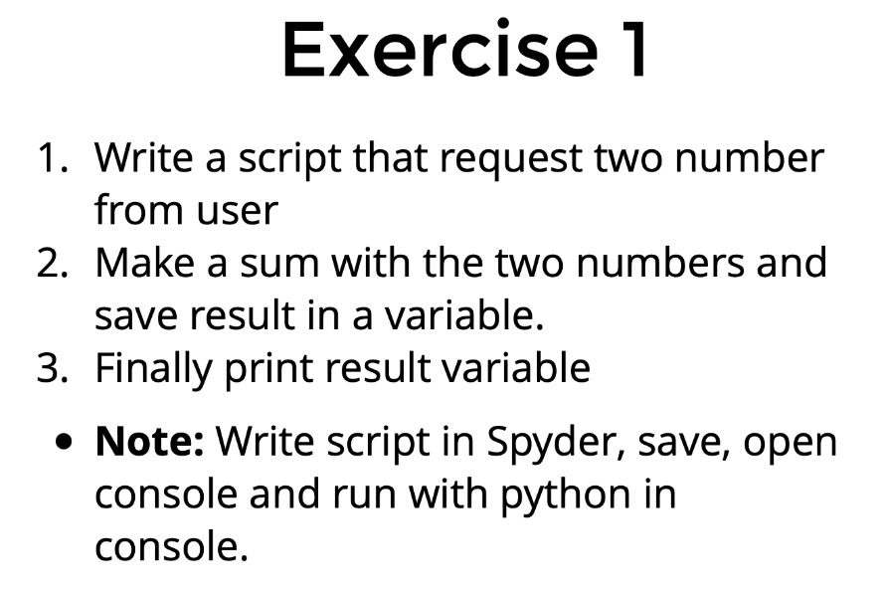
Exercise 1

Slide 93
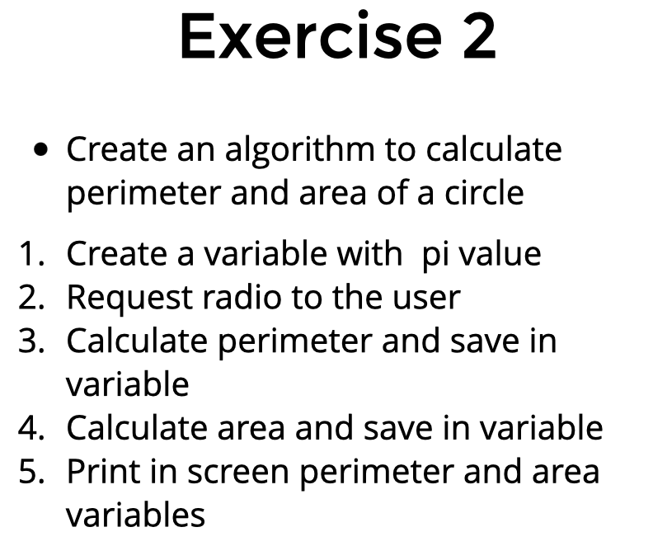
Exercise 2

Slide 94
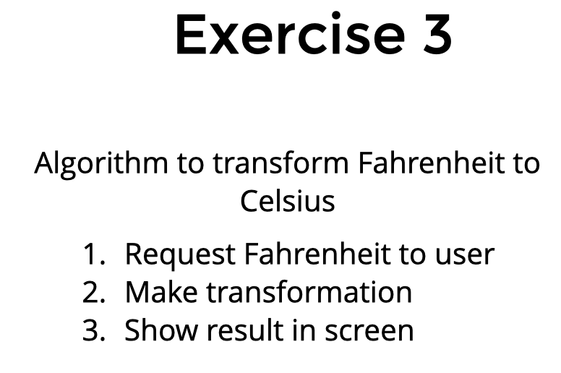
Exercise 3

Slide 95
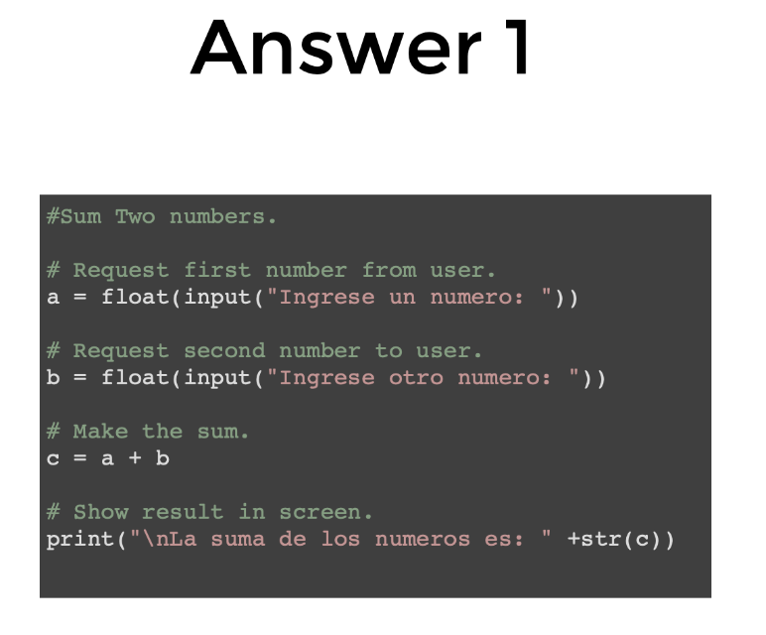
Answer 1

Slide 96
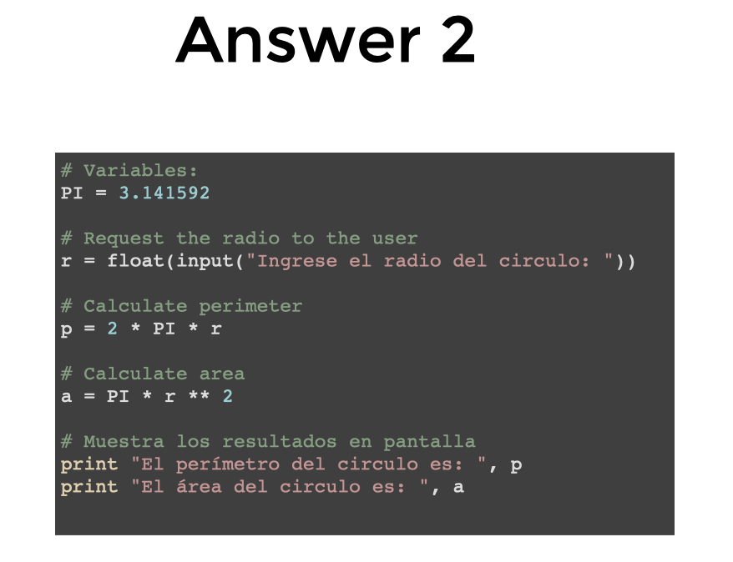
Answer 2

Slide 97
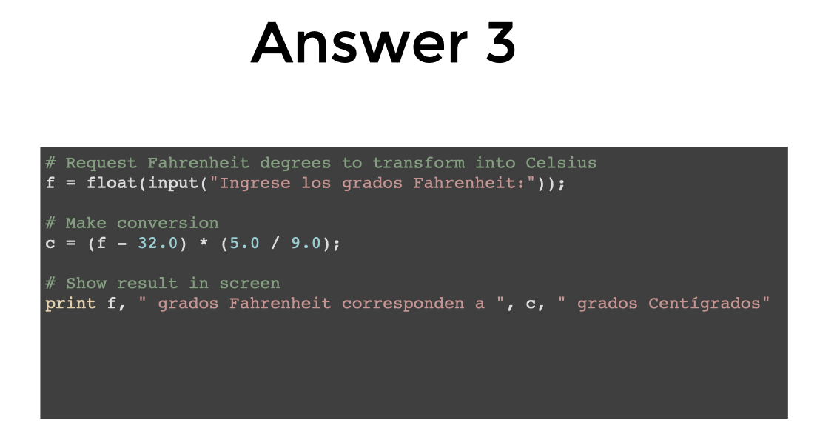
Answer 3

Slide 98
Agenda
Variables
Types
Arithmetic operators
Boolean logic
Strings
Printing
Exercises

Slide 99
Strings
Powerful and flexible in Python
Can be added
Can be multiplied
Can be multiple lines

Slide 100
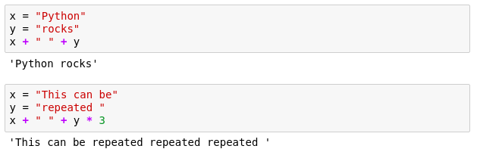
Strings

Slide 101
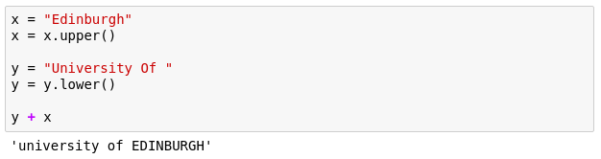
Strings
These are called methods and add extra functionality to the String.
If you want to see more methods that can be applied to a string simply type in dir('str')
Notes:
Functionality of strings can be extended through methods
should be in your notebooks but the dir() can be used on any Object/variable

Slide 102
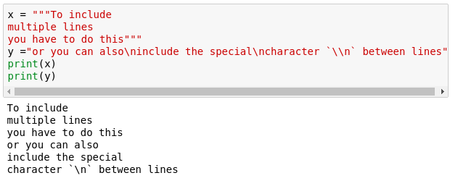
Multiline strings
Notes:
Sometimes we need strings on multiple lines. How? Two ways?
One is using triple quotes """
The other one is using the new line character - \n

Slide 103
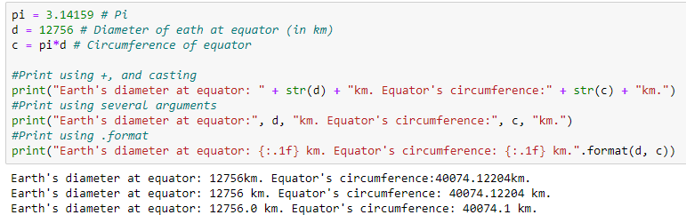
Placeholders
A way to interleave numbers is
Elegant and easy
more in your notes
Notes:
More examples including Exp, Octal, Hex, Etc in your notebooks

